Slide 1

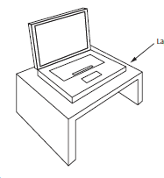






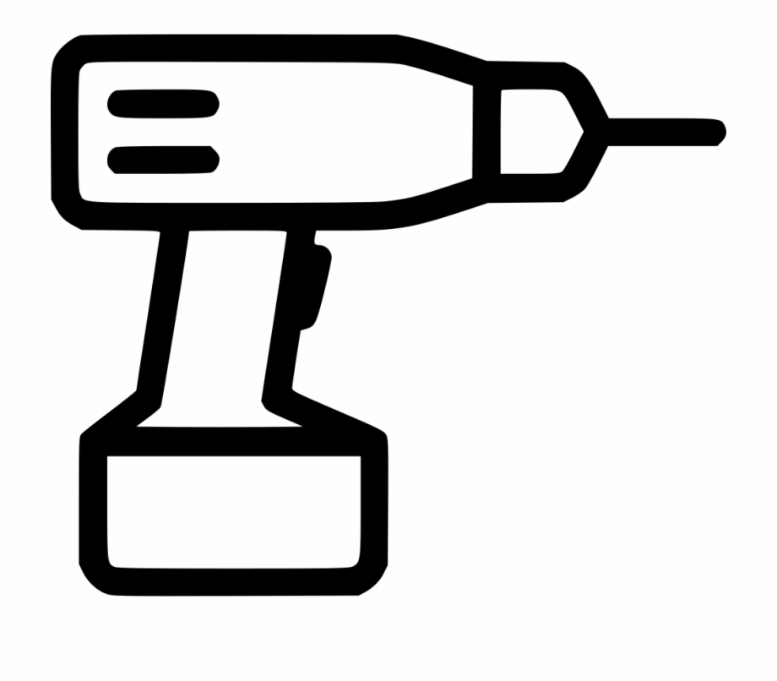





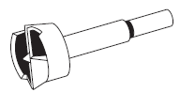
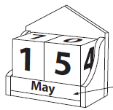





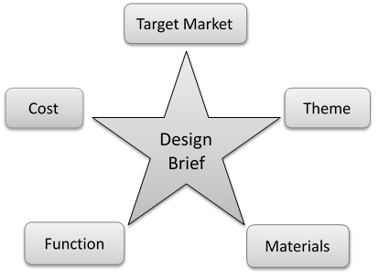







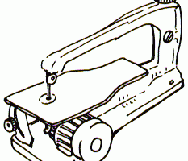

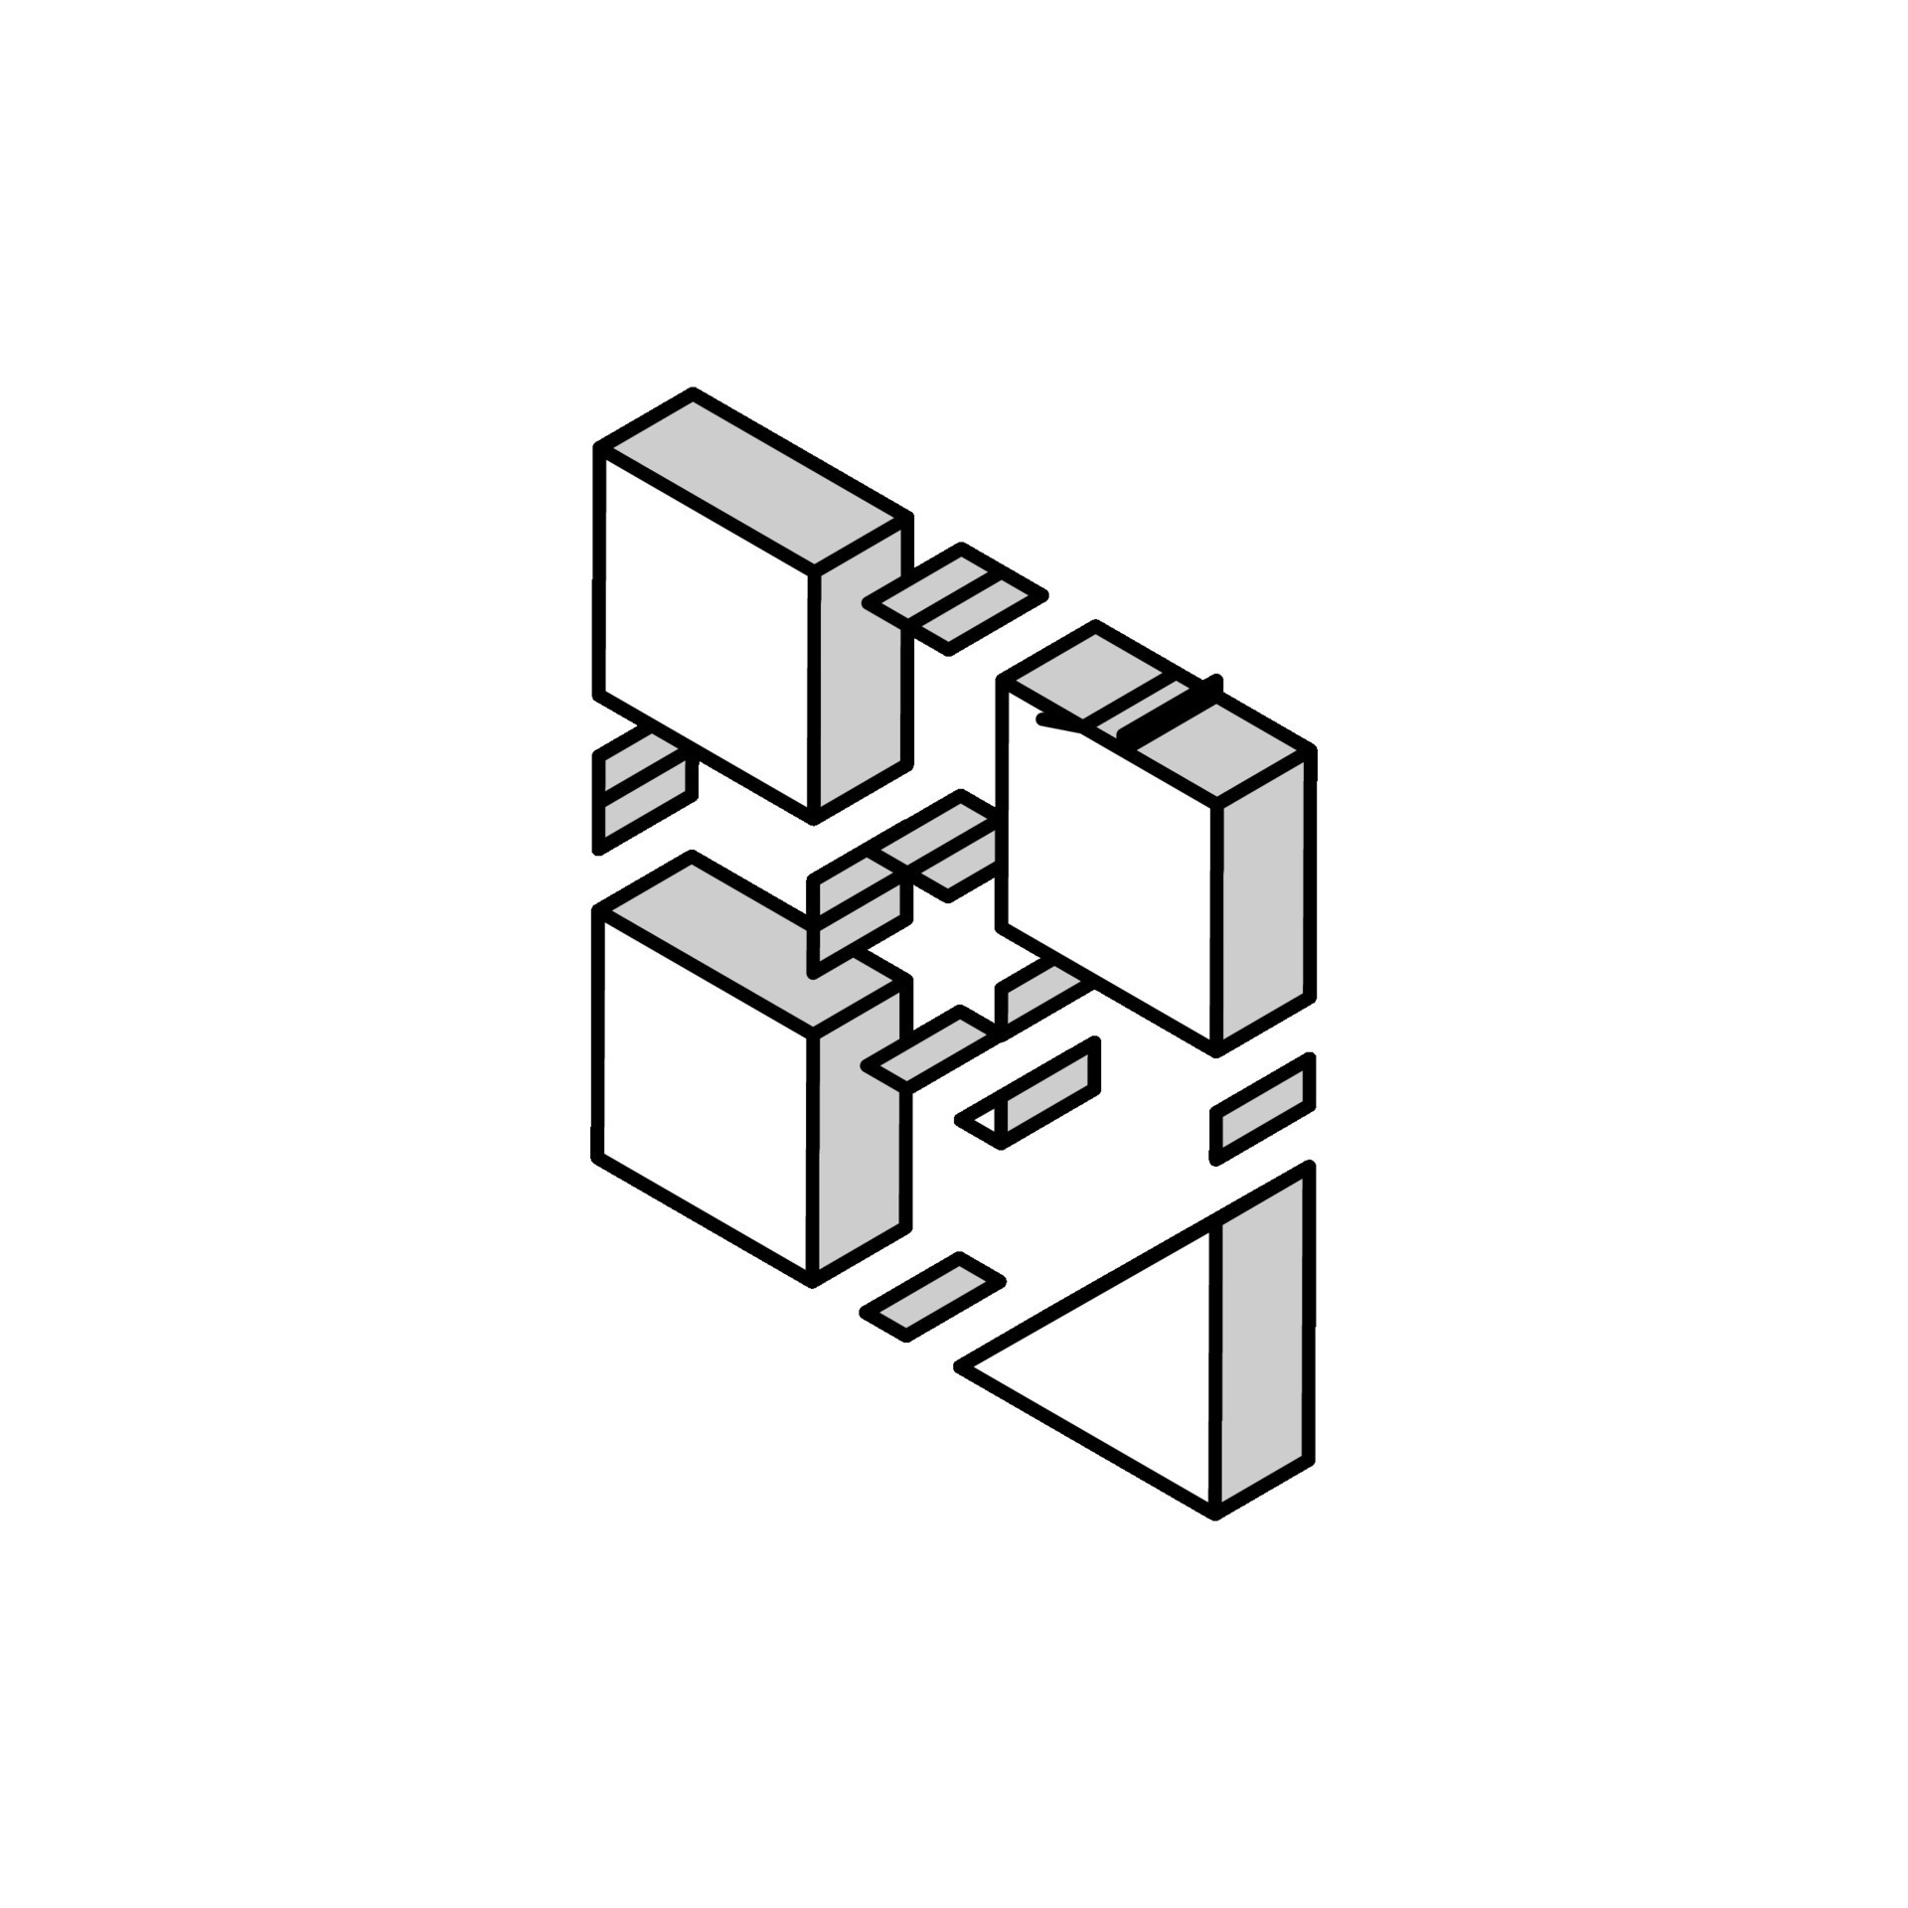



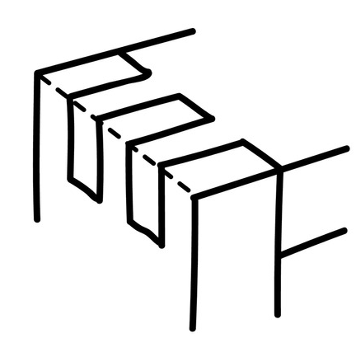

Design Technology Curriculum Map
A Level
Design modifications
Timber properties and sources
Materials
Mechanical Components
Final Controlled Assessment
Exam
Theory Specialist Exam Content
Theory Specialist Exam Content
Product evaluation
Smart Materials
NEA Coursework 50%
(Evaluation)
Design and Technology in our world
Electronics
Product testing and analysis
Assembly
Product
Modeling
Laser cutter
CAD design
Product
Modeling
Product testing and analysis
NEA Coursework 50%
(Manufacture)
NEA Coursework 50%
(Design)
Developing
Support Applying for FE in Tech
Tools
Manufacture skills
Hand Tools
Iterative Design
Museum Trip
YEAR
13
Brainstorming Ideas
Research
Market Research
Product Specification
Controlled Assessment
Making Choices
Ideas
NEA Coursework 50%
(Research)
NEA Coursework 50%
(Design)
NEA
Ideas
Research Analysis
Related product analysis
Existing Products
Design Ideas
drawing
Design Brief
Design Brief
Risk assessment and Health and safety training
Properties and materials
Museum Trip
Laser cutter
Drawing
Types of Finish
Scroll Saw
Pillar Drill
YEAR
Mini NEA: Table
Lamp
12
CAD/CAM
Laith
Manufacture
skills
Joints
Hand Tools
Design Brief
CAD/CAM
Manufacture
skills
Card
Modeling
Research
Presentation
In KS5 Product Design, we aim to create a stimulating and independent environment where students can develop the skills from KS3 and KS4 to a deeper level. Students are able to work in the workshops and department using their independent time effectively.
Students are given opportunity to learn new skills in CAD/CAM, woods, metal, plastics and 3D printing.
We encourage our students to make independent choices and tailor the second part of the Year 12 course to meet the needs of the individual students.
Over time we aim to prepare students for further education in the subject and help to support them with the application process.
YEAR
7

