Slide 1


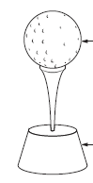


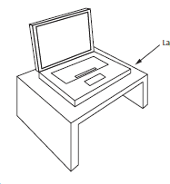

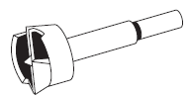
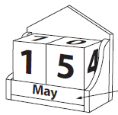

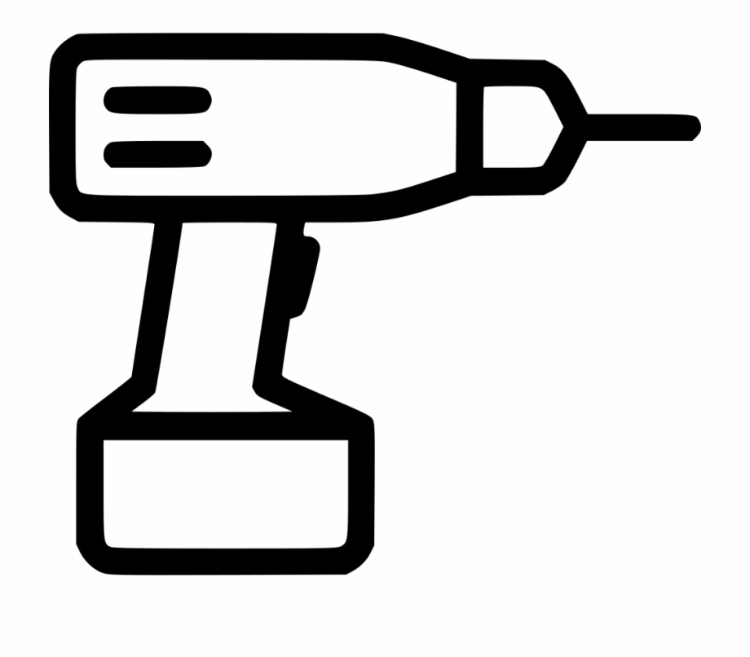



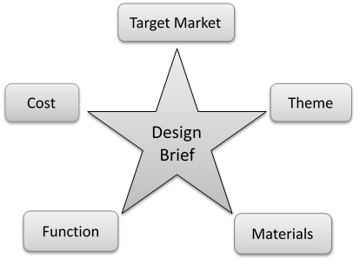






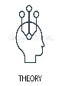

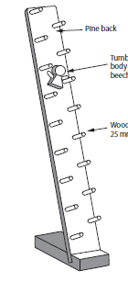


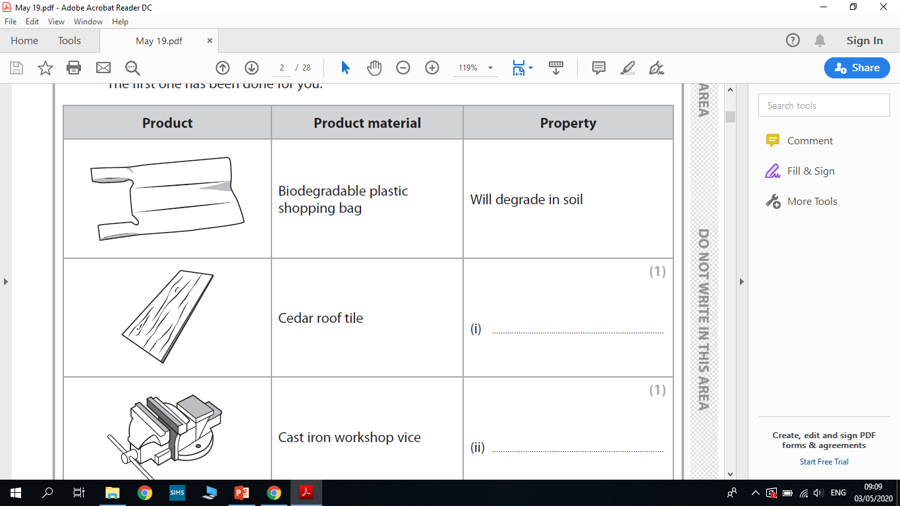




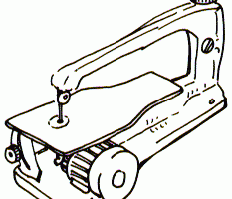

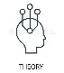
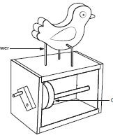


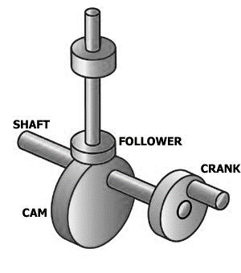




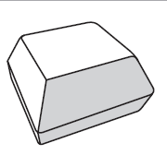


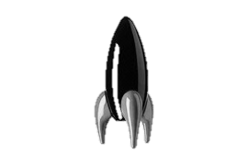




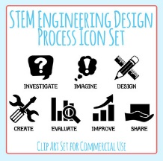




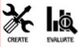


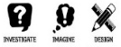



Design Technology Curriculum Map
Year 7
Teach – Boost – Teach – Diagnosis – Therapy - Testing
Year 11
In Design and Technology our curriculum is designed to encourage creativity with a core focus on skills and technical knowledge. Our intent is to educate our students to be knowledgeable about product design with an understanding of how companies and communities are impacted by this vast design industry.
We ensure a range of materials are revisited each year to build on depth of understanding, independence and safety within the workshop. We encourage our students to be challenged with problem solving tasks whilst developing skills in the workshop and in CAD.
Design modifications
Materials
Materials
Mechanical Components
Electronics
Timber properties and sources
Theory Specialist Exam Content
Theory Core Exam Content
Exam & Post – 16
Destination
Product evaluation
Manufacture skills
Smart Materials
Product testing and analysis
GCSE NEA Coursework 50%
(Evaluation)
Tools
Design and Technology in our world
Assembly
Product
Modeling
CAD design
Related product analysis
Brainstorming Ideas
Product testing, analysis and evaluation.
Manufacture
YEAR
Final
Product
CAD design
11
=
Product evaluation
GCSE NEA Coursework 50%
(Design and Manufacture)
GCSE NEA Coursework 50%
(Research)
Design modifications
Iterative Design
Product Specification
Product Specification
Market Research
Iterative Design
Risk assessment
Design Ideas
drawing
Research Analysis
Design Ideas
drawing
Practice NEA
Joints
Quality Assembly
Plastics
Design Brief
Existing Products
Development
Modeling
Accuracy of finish
Machine tools
Vax forming
Market Research
YEAR
10
Practical Skills Board
Practice NEA
Product Specification
Product evaluation
Product
Evaluation
Marking
out
Manufacture
Smart Materials
Product Specification
Initial
Ideas
Mechanisms
Types of Finish
Hand tools
Scroll Saw
Pillar Drill
Research Analysis
Linkages
Finger Joint
Design Brief
Hand tools
Marking
out
Timber
Electronics
Plastics
Timber
Mechanisms/Cams
Flowchart
Planning
Life cycle
analysis
Cams
Storage
Lamp
YEAR
9
Plastics
Types of finishing
2D Design
Contours
Design Brief
Timber
Marking out
Product
Evaluation
2D Design
Contours
Product
Evaluation
Laser cutting
Plastics
Design
Printing
Product
Evaluation
YEAR
Metal Casting
Timbers
Electronics
Timber
Design Brief
CAD
8
Accessories
Smart Sign or Mood Light
Graphics: Merchandise
Paper and
Card
Laser Cutter
PCB’s
Electronic Components
Product
Evaluation
Risk
Assessment
Forming
Circuitry
Graphic
finish
Market Research
Manufacturing
Sketch
drawing
Photoshop
Product
Evaluation
Design Process
Isometric
Drawing
Board games
Marking out
Design Brief & Specification
Graphic
finish
Paper and Card
Mood Boards
Health and safety
Health and safety
Scroll Saw
YEAR
CAD
Desk Tidy
Acrylic clocks
7
Plastics
Research
Design Process
Pillar Drill
Design Process
Research
2D Design
Contours
Lap Joint
Timbers
Fixtures
Plastics
Live Life • In All Its • Fullness • John 10:10

