Slide 1






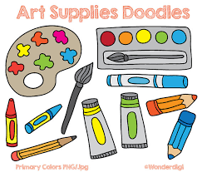










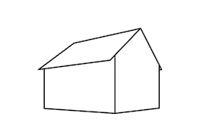
Art and Design Curriculum Map
A Level
Drawing
Photography and editing
Ideas
Idea development
Reviewing and refining ideas
Exploring materials, techniques and processes.
Idea development
Controlled Assessment
Exam
Externally Set Assignment
Externally Set Assignment
Personal
Investigation
Exploring materials, techniques and processes.
Drawing
Research
Conclusion Ideas
Finish Dissertation Writing
Controlled Assessment
Reviewing and refining ideas
Idea development
Research
Exploring materials, techniques and processes.
Idea development
Reviewing and refining ideas
Dissertation Writing
Research
Personal Investigation
Personal Investigation
Conclusion Ideas
Support Applying for FE in Art
Photography and editing
Gallery Trip
YEAR
Exploring materials, techniques and processes.
Dissertation Writing
Conclusion Ideas
Personal Response Ideas
13
Research
Drawing
Ideas
Exploring materials, techniques and processes.
Personal Response Ideas
Idea development
Controlled Assessment
Exploring materials, techniques and processes.
Personal Investigation
Personal Investigation
Skills Workshops
Photography and editing
Sketchbook Presentation Skills
Idea development
Exploring materials, techniques and processes.
Dissertation Writing
Reviewing and refining ideas
Gallery Trip
Making Choices
Exploring Materials
Ideas
Paint
Sketchbook Presentation Skills
Gallery Trip
Research
Photography and editing
Drawing
Drawing
YEAR
Three-dimensional Form
Painting
Mixed media and Collage
12
Ideas
Sketchbook Presentation Skills
1, 2 and 3 Point
Perspective
Drawing
Photography and editing
Sketchbook Presentation Skills
Exploring materials, techniques and processes.
Research
Research
In KS5 Art and Design, we aim to create a stimulating and independent environment where students can develop the skills from KS3 and KS4 to a deeper level. Students are able to work in a sixth form art studio, using their independent studio time effectively.
Students are given opportunity to learn new skills in oil painting, 3D materials, a more advanced level in photography and photoshop, printing processes and textiles.
We encourage our students to make independent choices and tailor the second part of the Year 12 course to meet the needs of the individual students.
Over time we aim to prepare students for further education in the subject and help to support them with the creative arts application process.
YEAR
7

