Slide 1

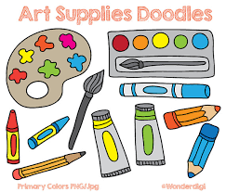


























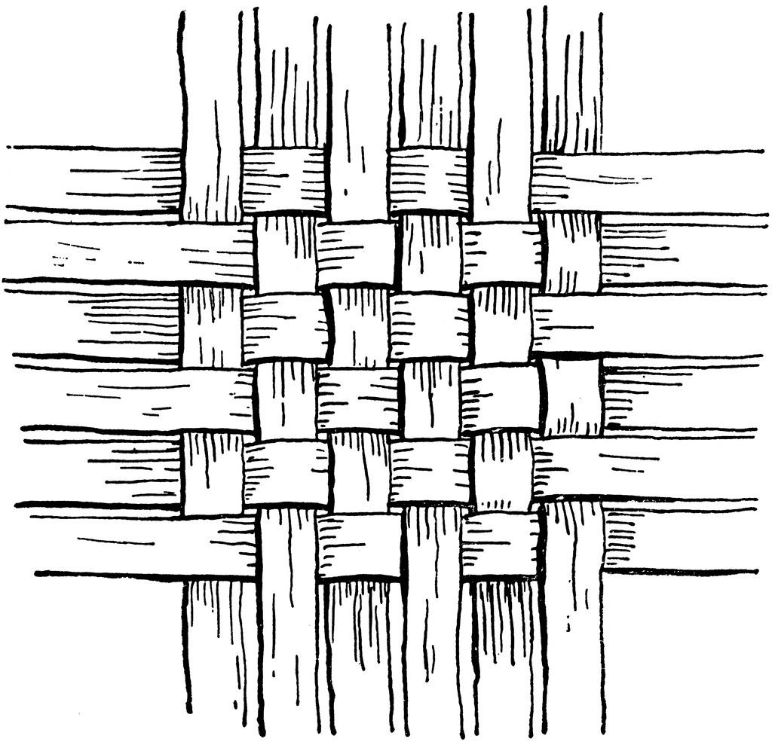




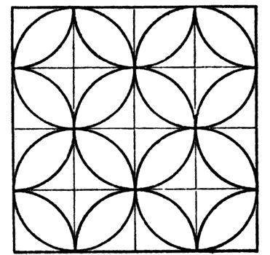





Art and Design Curriculum Map
Year 7
Teach – Boost – Teach – Diagnosis – Therapy - Testing
Year 11
In Art and Design, we aim to create a safe and inspirational environment where students can learn transferable art, craft and design skills.
A key focus in each year are the formal elements of line, tone, texture, form and colour. Students are given repeated opportunities to develop and build on core skills such as drawing, painting and in a range of other materials such as printing, textiles, collage, pastels and inks. Idea development is a key focus in every year, with purposeful links to artist history and other contextual sources. In KS4 onwards, digital photography and creative CAD forms part of the creative processes along with greater depth in annotations and explaining . We encourage our students to challenge themselves to strive for the highest standards and take away an informed view of the creative arts and design industry. Over time we aim to develop student’s ability to be creative in developing ideas and experiment with materials.
Controlled Assessment- Sustained project conclusion
Research
Idea development
Exploring materials, techniques and processes.
Reviewing and refining ideas
Idea development
Ideas
Ideas
Reviewing and refining ideas
Component 2: Externally Set Assignment
Component 2: Externally Set Assignment
Exam & Post – 16
Destination
Exploring materials, techniques and processes.
Drawing
Making Choices
Controlled Assessment – Walking Talking Mock
Exploring materials, techniques and processes.
Controlled Assessment-Final Exam
Component 1: Sustained Project
Ideas
Exploring materials, techniques and processes.
Research and investigation into contextual sources
Idea development. Brainstorming
Controlled Assessment- realisation of initial ideas
Idea development
Paint
YEAR
Ideas
Component 1: Sustained Project
11
Component 1: Sustained Project
Drawing- ideas.
Reviewing and Refining
Making decisions of themes and ideas
Paint
Photography and editing
Idea development
Research
Component 1:
Sustained
Project
Materials
Paint
Exploring materials, techniques and processes.
Idea development
Drawing- tone, texture and form
Drawing- tone, texture and form
Printing
Photography and editing
Exploring materials, techniques and processes.
YEAR
10
Still Life
Portraits and Landscapes
Research
Texture and mark making
Gallery Trip
Photography and editing
Research
Drawing- tone, texture and form.
Photography and editing
Research
Materials
NEA:
Icons
Exploring materials, techniques and processes.
Drawing
Paint
Texture and mark making
Materials
Research
Materials
Pattern
Paint
YEAR
Animals
Biomorphic Textiles
Biomorphic Art
9
Materials
Idea development
Form
Drawing
Idea development
Colour
Theory
Drawing
Landscapes
Research
Idea development
Textiles
Ideas
Materials
Texture and mark making
Form
Colour
Theory
Industry
Links
Printing
Paint
Texture and mark making
Art History
YEAR
Textiles
Drawing
8
Drawing
Textiles
Painting Techniques and Abstract Art
Printing
Drawing skills
Research
Idea development
Industry
Links
Printing
Drawing
Materials
Colour
Theory
Ideas
Materials
Textiles
Pattern
Colour
Theory
Idea development
Colour
Theory
Colour
Theory
Paint
Paint
Trees
Ideas
Culture
Drawing
YEAR
20th
Century Art
Masks
Basic Skills
7
Art History
Idea development
Colour
Theory
Materials
Form
Drawing
Research
Drawing
Paint
Research
‘Live life In all its fullness’ John 10:10

