Slide 1
Product Design
GCSE to A Level Transition Work

Slide 2
A Level Product Design
Learning about Design and Technology at A level strengthens learners’ critical thinking and problem-solving skills within a creative environment, enabling them to develop and make prototypes/products that solve real-world problems, considering their own and others’ needs, wants, aspirations and values.
The A Level qualification requires learners to identify market needs and opportunities for new products, initiate and develop design solutions, and make and test prototypes/products.
Learners should acquire subject knowledge in design and technology, including how a product can be developed through the stages of prototyping, realisation and commercial manufacture.
The course is structured to provide a broader insight into the word of design covering design influences including design genres, iconic products, famous designers and architects.
Its aim is to provide a foundation for students to confidently problem solve with innovation and independence at the core of students learning.

Slide 3
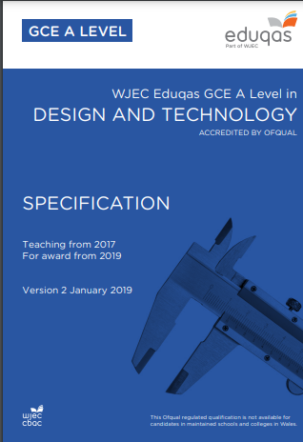

Link to Specification and further information
https://www.eduqas.co.uk/media/kclpvixc/a-level-design-and-technology-specification.pdf
To help you with the transition between GCSE to A-Level DT look at this website:
https://resources.wjec.co.uk/Pages/ResourceSingle.aspx?rIid=3980&langChange=en-GB

Slide 4
The tasks set below are designed to increase your awareness and curiosity of design, challenging your perception and understanding of the design process.
Tasks
Task 1
Visit one of the following online or in person, record your thoughts via a sketchbook or in a PowerPoint digitally. Include pictures of interest and any relevant information.
• Design Museum, look at the current exhibition and designers in residence.
• Architecture – Buildings in the square mile, financial district of London – Lloyds building, Gherkin, Leadenhall Building (cheese grater) or any other. You will need to research the design and construction of the building you have chosen to research including background information about the architect, inspiration, designed for who, construction materials, environmental impact.
• Victoria & Albert Museum – 20th Century exhibition and furniture. Record products of interest, include images and designer information

Slide 5
Task 2
Tasks
Please read and research the website as it will inform, inspire and shape your understanding of Design.
You need to identify one article, commenting on how has it inspired you, what you have learnt and how you could proceed with your research.
• https://inhabitat.com/design/

Slide 6
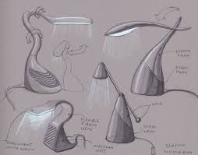
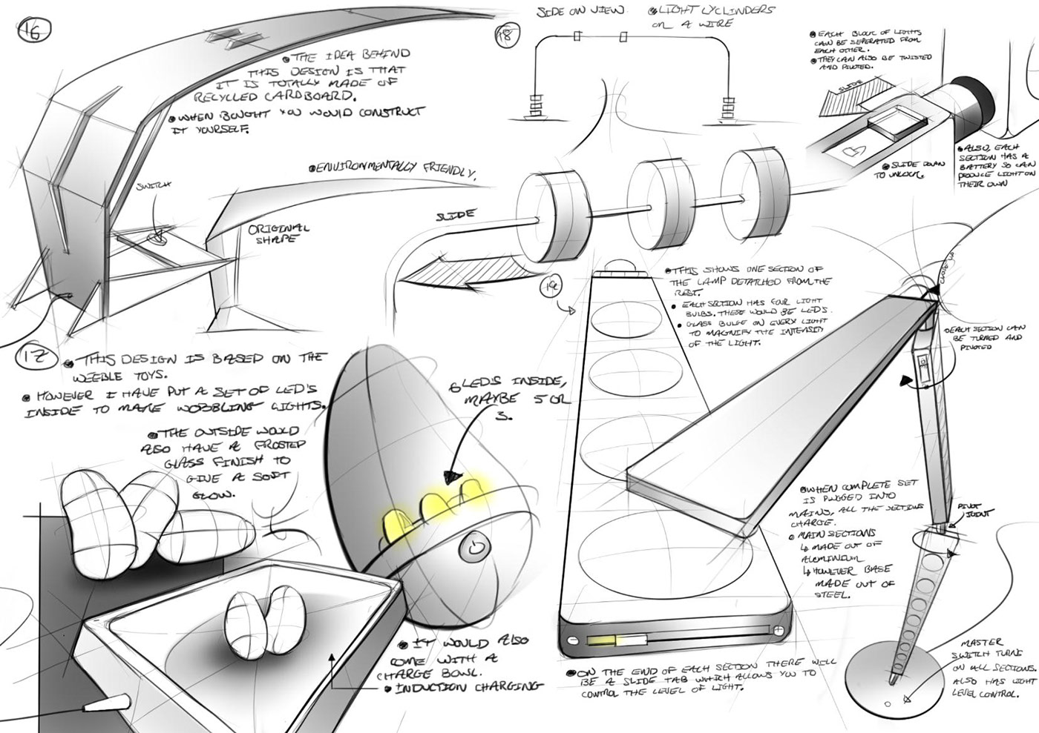
Task 3 Design a lighting product.
Tasks
This task needs to be completed on paper only or in a design journal.
We want to see your approach to sketching, problem solving, creativity and innovation.
You may research materials, existing products, energy sources and industrial processes.
The task provides the opportunity to think outside your comfort zone, challenge yourself to be innovative and think differently.
Check out these ideas
(2281) Pinterest

Slide 7
Useful reading:
20th Century Design – Catherine McDermott
https://books.google.co.uk/books/about/The_Design_Museum_Book_of_20th_Century_D.html?id=kSpQAAAAMAAJ&redir_esc=y
Product Design and Sustainability: Strategies, Tools, and Practice – Jane Penty
https://www.google.co.uk/books/edition/Product_Design_and_Sustainability/PbGStAEACAAJ?hl=en
https://en.wikipedia.org/wiki/The_Design_of_Everyday_Things

