Slide 1

Sociology Transition Work
What is Sociology?

Slide 2

What is Sociology all about?
Think about this question. Create a spider diagram/mind map to have a the start of your notes to pull together your ideas. You can use words and pictures to illustrate your ideas.
Now watch this video on YouTube (it is American so watch out for some differences and pause occasionally!) and add ideas to your spider diagram in a different colour. https://youtu.be/YnCJU6PaCio?si=6z4mhaNgpIMx2Oum
Summarise: in 50 - 100 words ‘What is Sociology?
Morning Routine: Write a list of everything that you do in the order that you do it in, in the first hour after waking up in the morning.
Now talk to others - consider how your daily routine compares to those of your family and peers. List what you do the same and what you do differently. What does this tell us about ourselves as individuals? Are we born with this routine or socialised into it? Write up your thoughts.

Slide 3

Research
Find the definitions for the following concepts (start a key word glossary) :
➢ Socialisation
➢ Primary socialisation
➢ Secondary socialisation
➢ Agents of socialisation
➢ Institutions/Agencies in Society
➢ Norms
➢ Values

Slide 4
Thinking sociologically
This is a concept established by C Wright Mills which provides a framework for understanding our social world that far surpasses any common sense notion we might derive from our limited social experiences. The sociological imagination is making the connection between personal challenges and larger social issues. Mills identified “troubles” (personal challenges) and “issues” (larger social challenges). In other words, this mindset provides the ability for individuals to realise the relationship between their personal experiences and the larger society in which they live their lives.
personal troubles: private problems experienced by one individual and the range of their immediate relation to others
public issues: issues that lie beyond one’s personal control and the range of one’s inner life, rooted in society instead of at the individual level sociological imagination: the use of imaginative thought to understand the relationship between the individual (personal troubles) and the broader workings of society (public

Slide 5
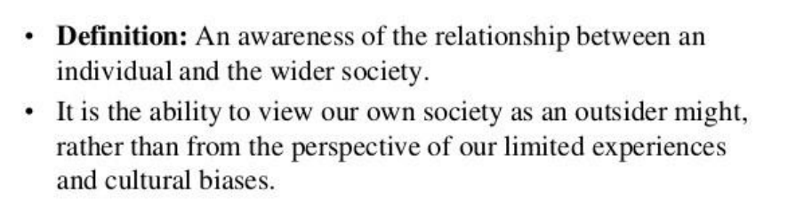

The Sociological Imagination
How/why is Sociology ‘anti-individualistic’?
What is the difference between opinions and arguments?
Why do you think it is important to be a critical thinker?
Watch the videos:
Sociological Imagination (youtube.com)
The Sociological Imagination - Private Troubles, Public Issues (youtube.com)
Then with an example that works for you but that can apply to the UK explain the difference between personal problems and public issues.

