Slide 1



Alternative Academic Qualification (AAQ)
Health & Social Care
Introduction to Sixth Form
Name: ______________________

Slide 2

Contents
What will I be studying? Page 3
Recommended Netflix Programmes Page 4
Other recommended watching Page 5
Recommended Reading Page 6
Recommended social media Page 7
Representations Task Page 8
Learning Log Page 9
Key word Glossary Page 10-11
A-Z Challenge Page 12
History of the NHS Page 13
Roles in Health and Social Care Page 15
Extension Task Page 16
Checklist for September Page 17

Slide 3
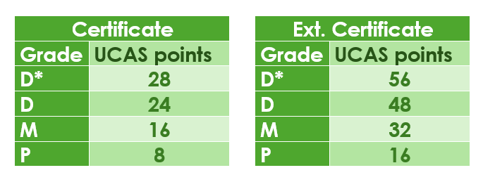
What will I be studying?
Health and social care is a subject that has many topic areas and is a good foundation subject for a wide range of careers.
In general, it’s about people, their health, individual circumstances and what affects individuals.
In this course we will explore what healthcare and social care service there are and how different job roles support people to meet their individual needs.
First year – Certificate
One exam assessed unit – Principles of health and Social Care
Two supervised assignments called NEA’s (non-examined assessment)
The NEAs are; Person-centred care and Supporting people with mental health conditions
You will have an opportunity to resit your exam and there will be a chance to improve some of your assignment work
Second year – Extended Certificate
One exam assessed unit – Anatomy & Physiology for health and social care
Two supervised assignments called NEA’s (non-examined assessment)
Your teacher will deliver the course content using a wide range of teaching methods.
You may be considering a career which requires a university degree and are thinking about UCAS points for the AAQ.

Slide 4













What the Health
Louis Theroux: Extreme love, Dementia
Babies
Five Feet Apart
Theory of Everything
Humans;
Body Systems
Three identical strangers
Brain on Fire
The Game Changer (2018)
Girl, interrupted
Call the Midwife
13 Reasons Why
Recommended Watching for Health & Social

Slide 5


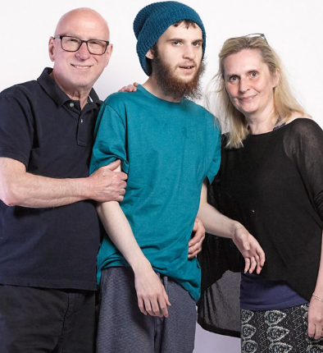


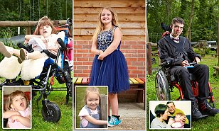
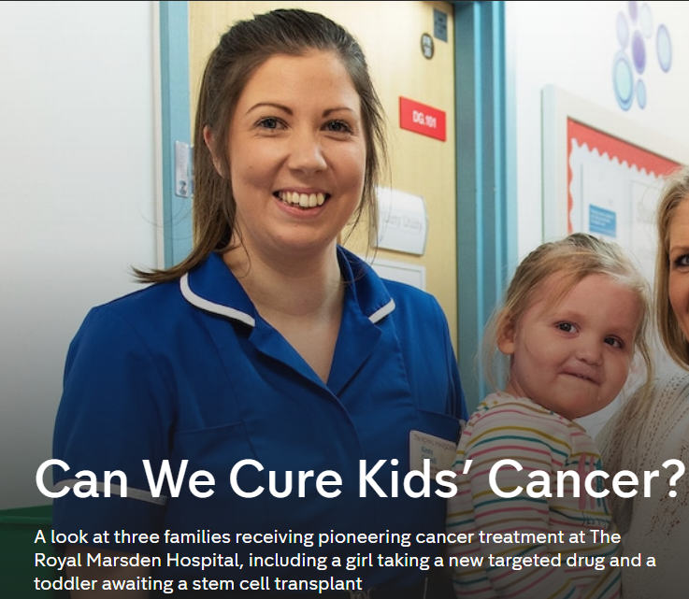





Not
Rhod Gilbert's Work Experience
Katie Price; Harvey and Me
Inside our Minds
Stacey Dooley 9-5 Care Home
BBC iPlayer
24 hours in A&E
Born to be different
The Royal Marsden
Losing it: Our mental health
All 4
Beyond weight loss
The Upside
ALLELUJAH
Miss you Already
Amazon Prime
No Netflix paid account

Slide 6

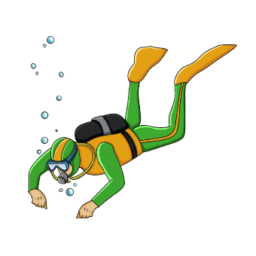












Dive into a book
Pig Heart Boy by Malorie Blackman
The Illustrated Mum Jacqueline Wilson
This is Going to Hurt by Adam Kay
When Breathe becomes Air by Paul Kalanithi
Further Reading
The Hate U Give by Angie Thomas
Me Before you by Jojo Moyes
The Fault in Our Stars by John Green
The Story of Baby P by Ray James
The Language of Kindness by Christie Watson
I am Malala by Malala Yousafzai
The Perks of Being a Wallflower Stephen Chbosky
Katie Price; Harvey
Recommended Reading for Health & Social Care
Yes, some of these are also films, if you prefer!

Slide 7


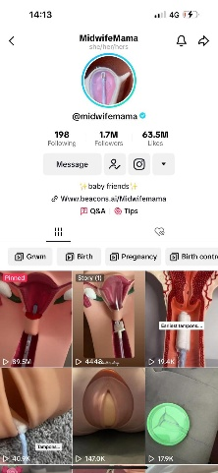
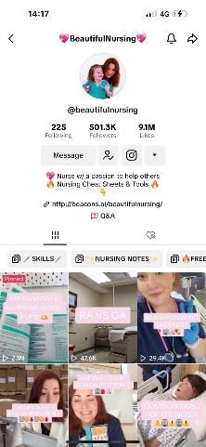

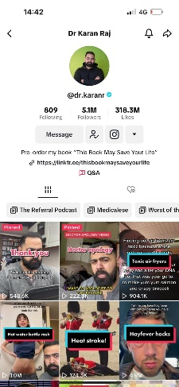
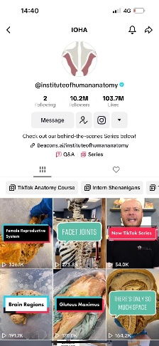

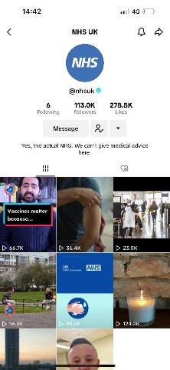


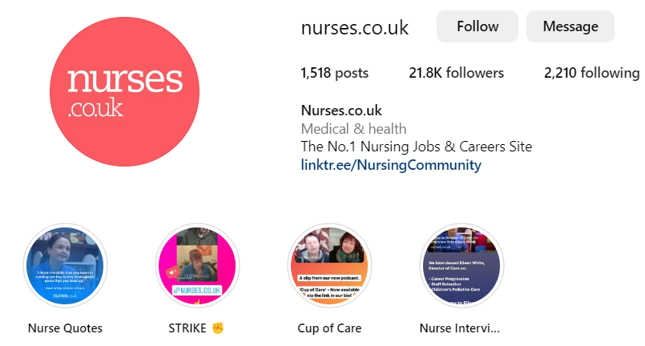
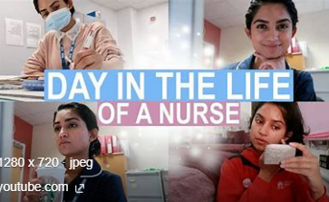
Social Media
Follow
Follow
@midwifemama
@beautifulnursing
@leilaincredible
@dr.karanr
@instituteofhumananatomy
@lubdubsblog
@nhsuk
@alliedhealthcareforme
Nurses.co.uk
@nursezara_uk
If you have any others, you think are good, let us know ☺

Slide 8


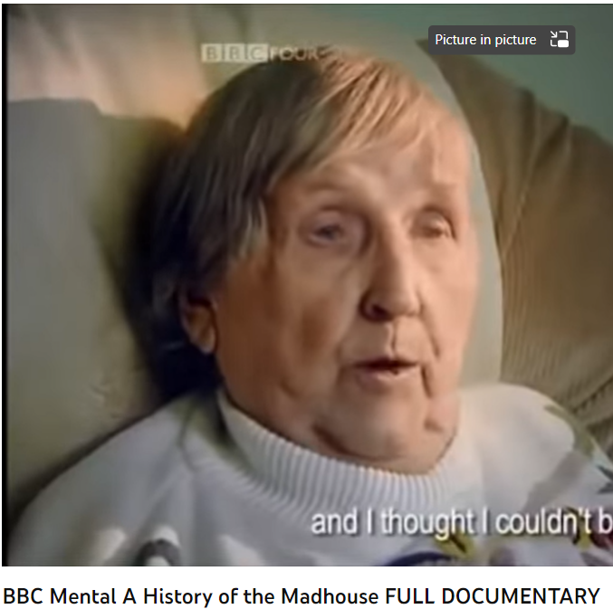
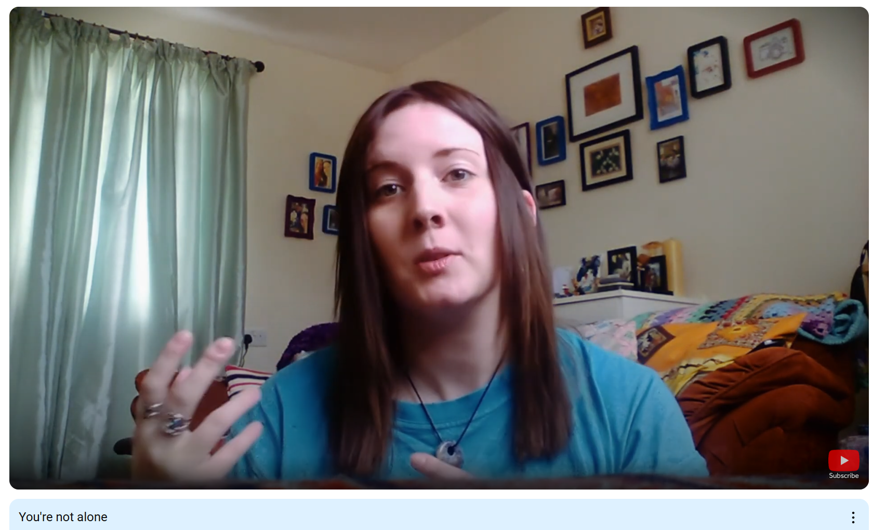
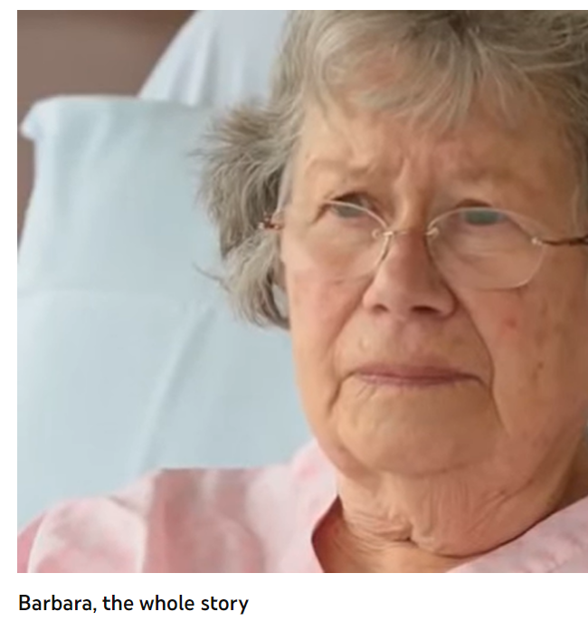
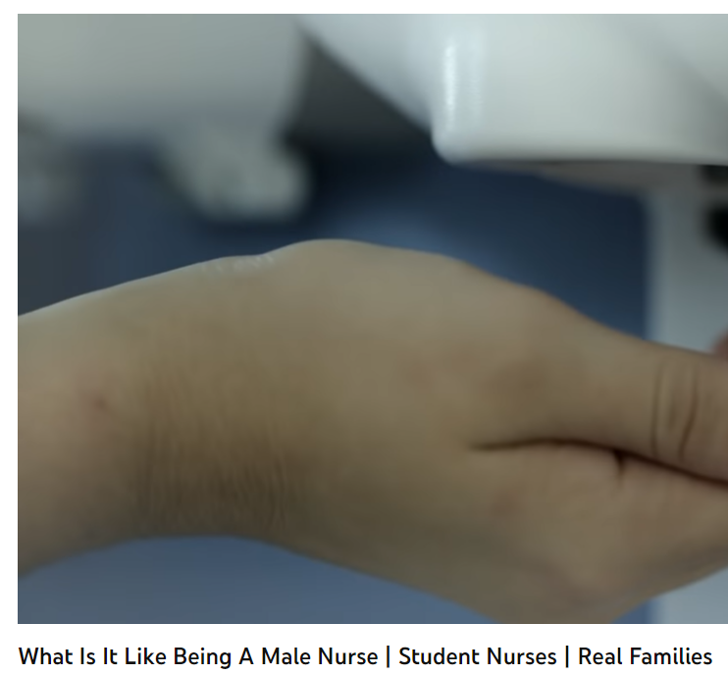
Health and Social Care in the Media
It is important to have a broad understanding of health care and social issues which affect services and professionals working for the NHS. One way of raising your awareness is to prepare you before your course starts with summer learning using different forms of media.
Your task is to pick…
➢ 2 Films
➢ 1 Book
➢ 2 Documentaries
You are then tasked with writing a report which is to be a minimum of half an A4 page with the following title: ‘Discuss the issues [in the film/book or documentary] and impact on health care provision’
You must watch or read using examples on the previous slides or another media resource relevant to your learning.
Consider the following:
What issues, if any, are being raised in the stimulus? E.g. dementia
How does the stimulus present health? E.g. care for people with dementia
Explain why the topic of the media source is relevant to your learning and whether you think it is helpful and why?
This list is NOT exhaustive there may be other questions/ideas you wish to consider as you watch or read – it would be lovely to share with us all.

Slide 9
Learning Log
Record here any additional reading/viewing you are undertaking in order to show what you have been completing in order to prepare you for the course.
Use the reading list on the previous slides you have been given for guidance on what you could you watch/read/research
Date | Title | Summary of content | My thoughts

Slide 10

Task: Research and define the following words which are words you will need to use correctly. Then, end column summarise the term visually to help you remember it.
Term | Definition | Pic/image/draw
Adolescence
Advocate
Attachment
Care package
Safeguarding
Discrimination
Diversity
Empathy
Ethical

Slide 11
Term | Definition | Pic/image/draw
Person-centred care
Care values
Holistic Approach
Multi-disciplinary team
Physiology
Health and care legislation
Risk Assessment
Meeting people’s needs
Self-Esteem

Slide 12



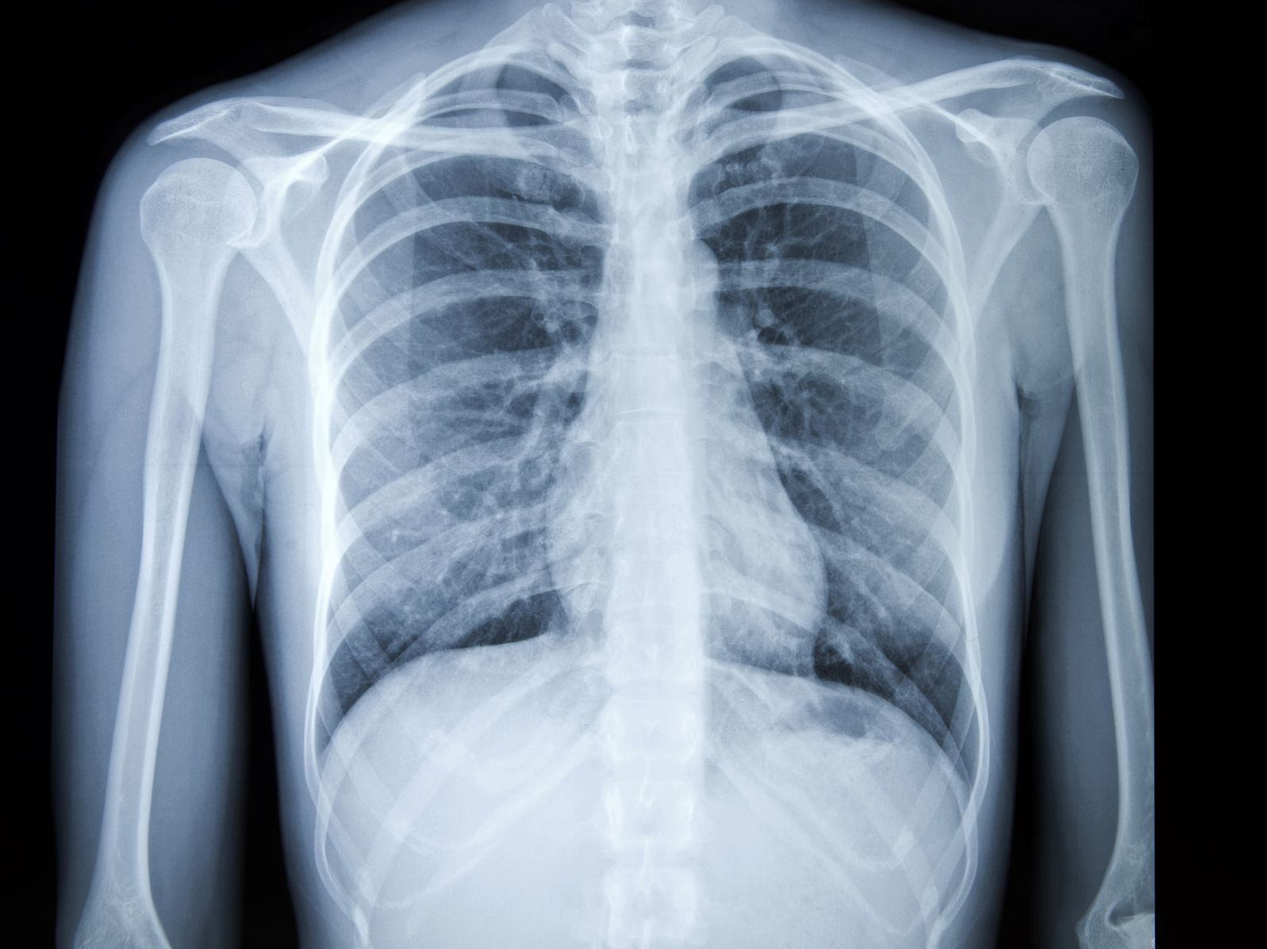


Research a list of Health and Social Care jobs/ medical terms for each letter of the alphabet
A
B
C
D
E
F
G
H
I
J
K
L
M
N
O
P
Q
R
S
T
U
V
W
X
Y
Z

Slide 13
An information leaflet task
Choose one of the below
Research the government recommendations for the below lifestyle factors and produce and educational information leaflet;
Alcohol units
Exercise
Hydration
Nutritional diet
Sleep
Smoking
Prescription and illegal drugs
Research different techniques to manage stress, worries and anxieties and produce an educational leaflet;
Grounding
Breathing exercises
Me time and saying no
Meditation
Avoid unhealthy habits

Slide 14

On ‘The front line’…….
What does it mean when people talk about being ‘on the front line’?
What does it mean when people talk about multidisciplinary teamwork?
Job Role | Definition | Roles and Responsibilities
District Nurse
Auxiliary Nurse
Palliative Care
Phlebotomist
Domiciliary Carer
Neonatal nurse

Slide 15
True or False?
Colour code the statements in order to show if they are true or false.
True False
A palliative care nurse will get involved with everyone who gets coronavirus.
A district nurse will only work with the elderly.
A midwife works with babies and children up to 5 years
Domiciliary carers provide care in the home.
Only phlebotomists are allowed to take blood.
Auxiliary nurses help support other nurses to do their roles.

Slide 16

Passport to Sixth Form
Check list
Use this list to make sure you have everything you need to hand in in September in order to start your AAQ Health & Social Care course.
Report/review on your chosen film, documentary and book in the media, page 7.
Complete at least a minimum of 5 sections of the learning log, page 9.
Completed glossary of key terms, page 10-11.
Filled in A-Z of Health and Social Care, page 12.
Information leaflet
Job role research from page 14
Overview of job roles, page 15
Pen case with pens, high lighters, pencil and rubber.
A positive attitude, a lovely smile and be ready to be yourself ☺

